Slide 1

INDEPENDENT PMS CENTRES OF BRUSSELS 1 AND BRUSSELS NORTH-WEST
POITIERS, 28 SEPTEMBER 2026
Presentation of the
Psycho-Medical-Social Centres
in French-speaking Belgium

Slide 2

Contents
01
Introduction
The school system in
French-speaking Belgium
02
03 Our two PMS centres
a) The Brussels context
b) How our centres are organised
c) The schools we support
d) Our day-to-day work

Slide 3
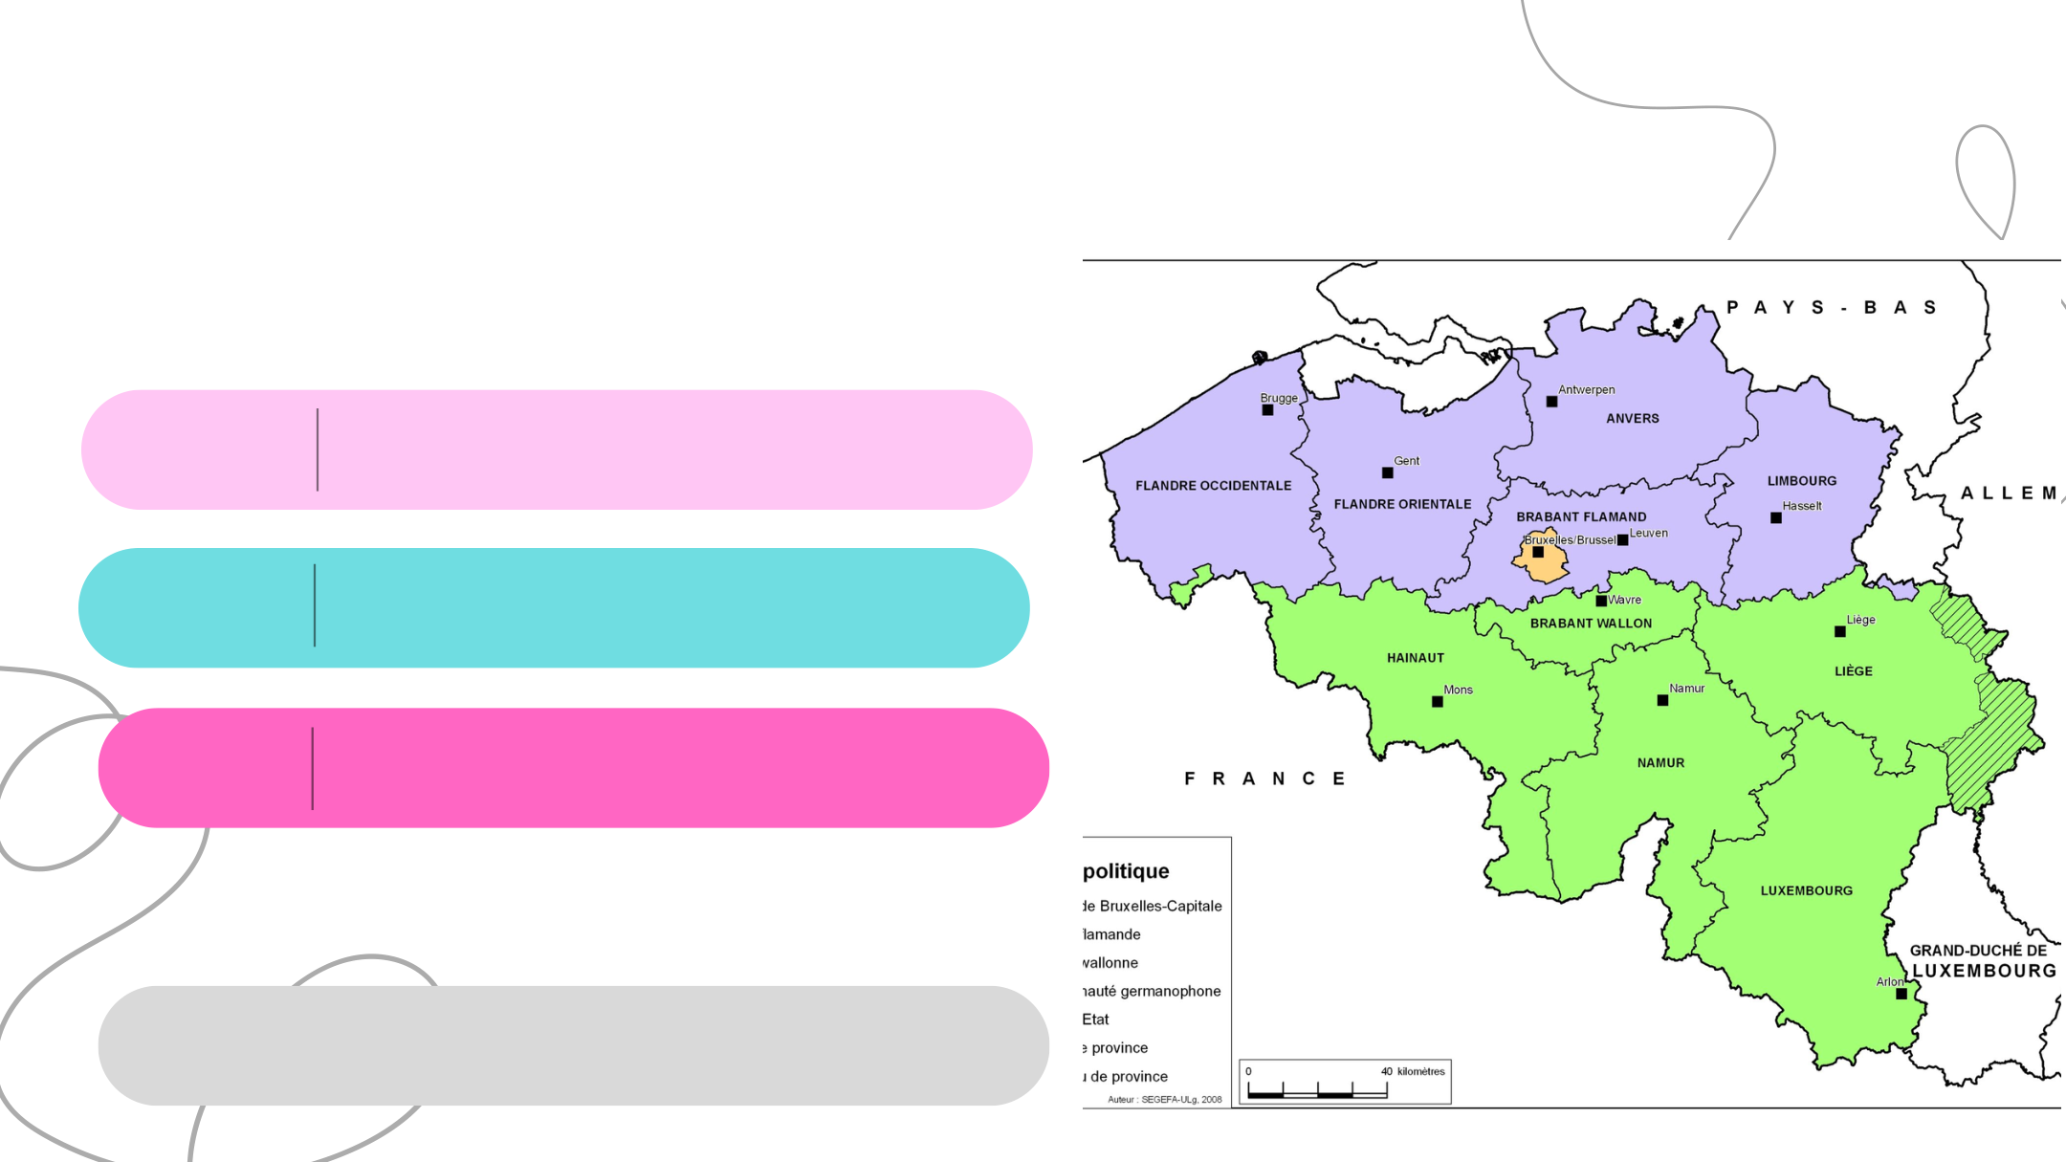
The school system in
the Wallonia-Brussels
Federation
Compulsory education
children aged 2.5 to 6
PRESCHOOL
school attendance compulsory from age 5
PRIMARY
children aged 6 to 12
SECONDARY
students aged 12 to 18
Non-compulsory education
Higher education: Universities and Universities of Applied Sciences

Slide 4
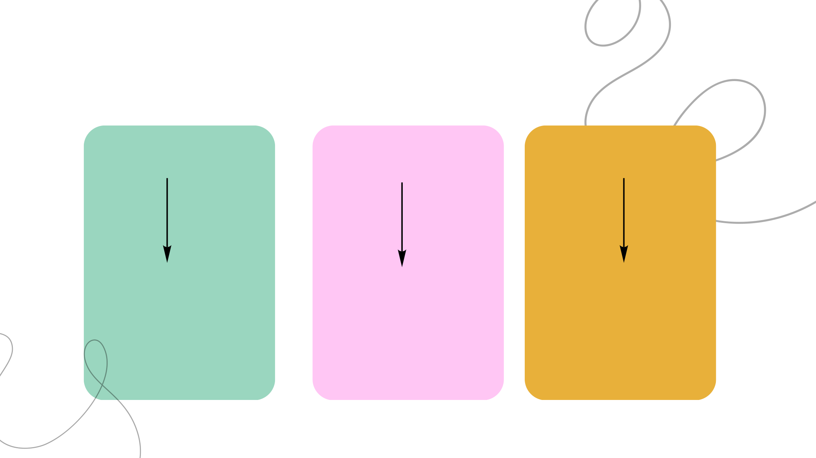
Secondary
education
From the third year
GENERAL
TECHNICAL
VOCATIONAL
Higher education
Higher education
Practical training
University
Universities of applied sciences
University
Universities of applied sciences
Employment
or
Employment

Slide 5

Students with
special educational
needs
INCLUSION
SPECIAL EDUCATION
SPECIALISED
in mainstream education
different types tailored
with support from the
to students’
disabilities and needs
Territorial Support Centres

Slide 6
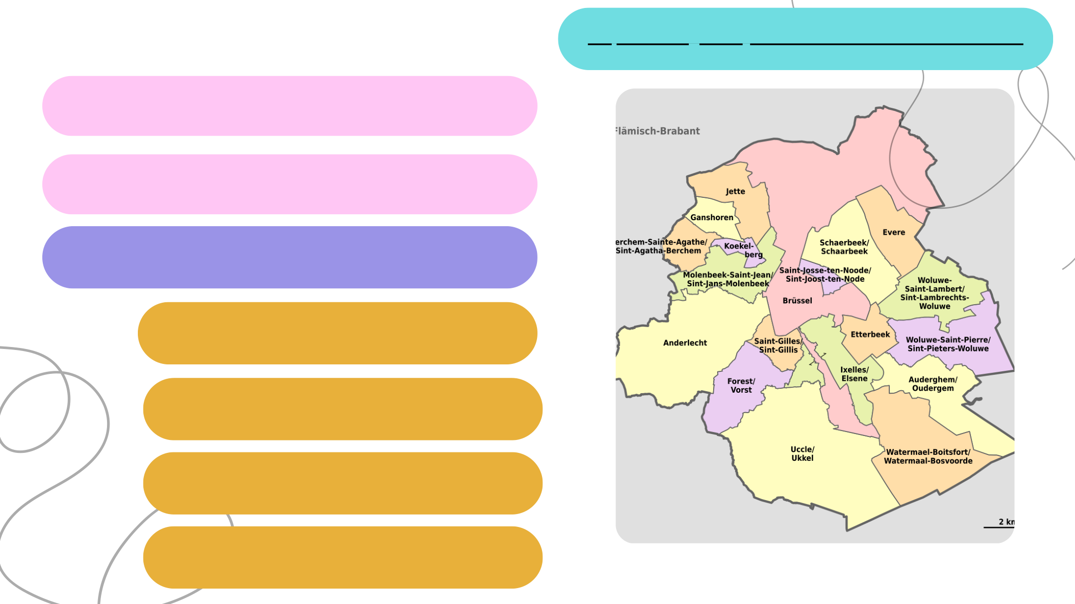
The PMS centres
https://view.genially.com/6915cf830594df4a7232bed8
Introduction to the independent PMS centres
Our two centres
The Brussels context
How our centres are organised
The schools we support
How do we work day to day?

Slide 7

Our partner schools
Team 1
North-West team
12 independent schools
9 independent schools
Preschools
Preschools
Primary schools
Secondary schools
Primary schools
Secondary schools
Independent PMS Centre 1 of
Independent PMS Centre of
Brussels North-West
Brussels
Mainstream schools
Mainstream schools
9,579 students supported by 18 FTE staff

Slide 8

Some examples of our activities
Services offered
Class visits to introduce the team and its work.
Participation in school start-of-year meetings ...
Responding to requests
Consultations with teachers and school leaders
Support with certain procedures ...
Prevention activities
Speech therapist’s work in preschool (observations,
advice to teachers and parents)
Classroom workshops ...
Identifying difficulties
Participation in class councils
Classroom observations ...
Assessment and guidance
Individual assessments
Meetings with students and families
Referrals to external services ...
Educational and career information and guidance
Information about the education system
Individual support with choices
Referral to special education ...
Parenting support
Family meetings
Parenting advice
Parent cafés ...
Health and well-being education
Contacts with family planning services
Individual consultations
Referrals to specialists ...

Slide 9

Our day-to-day work
Our core principles
Independence and methodological freedom
Priority for emergencies
Priority for requests from students and parents
Importance of on-site availability in schools
Confidentiality
Advisory, non-compulsory service
Free of charge
Service in and outside school
Making the PMS centre accessible
Participating in class councils
Choosing group or individual activities
Working with teachers and support centres on
reasonable accommodations
Promoting school engagement
Putting young people’s interests first
Priority for those requesting support
Assessing requests before providing support
Working in pairs within schools
Effective communication
Taking young people’s needs into account
Essential role of parents
Podcast by the Faut L’Dire group
Episode 1 – When one form of violence hides another
Annual evaluation of our work

Slide 10
INDEPENDENT PMS CENTRES OF BRUSSELS 1 AND BRUSSELS NORTH-WEST
HANOVER, 14–15 APRIL 2026
Thank you for your attention

